Slide 1
Microsoft Movie Studio Market Analysis
Aouther : Prince Obiero

Slide 2
Overview
This project explore current box office trends to help Microsoft make data driven decision as it enters the original movie production space.
Using dataset from IMDB and Box Office Mojo ,the analysis focuses on genre performance ,run time,audience ratings , and gross earnings.
The goal is to identify profitable film traits to inform strategic content development.

Slide 3
Business Problem
Microsoft is launching a new movie studio but lucks insight into what type of movies perform best commercially.
Understanding genre trends , runtime preferences , and audience reception can guide investment into films that maximize both critical and financial success.
Business Questions:
What type of movies generate the most revenue?
Do audience rating and number of votes correlate with higher gross?
How do gender and release year influence box office performance?

Slide 4
Data
Data sources:
imdb.title.basics.tsv.gz : Title, genre, runtime, year
imdb.title.ratings.tsv.gz : Average rating , number of votes
bom.movie_gross.csv : Domestic and foreign gross revenue

Slide 5
Methods
Data merged on unique film ID tconst
Missing values imputed appropriately(e.g, runtime mean)
Genres exploded for multi-genre analysis
Data modeling includes correlation analysis and group-based aggregation
Visualization tools: bar plots , heatmaps

Slide 6
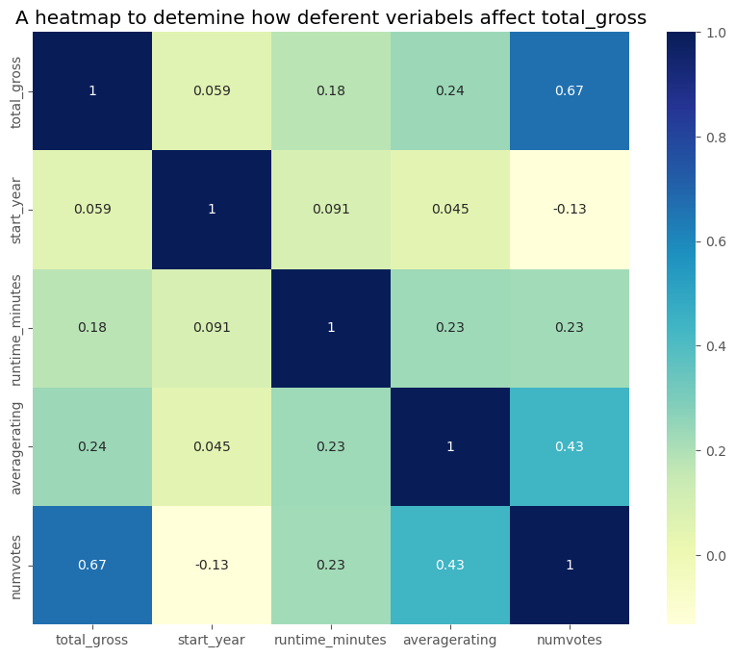
Correlation Heatmap

Slide 7
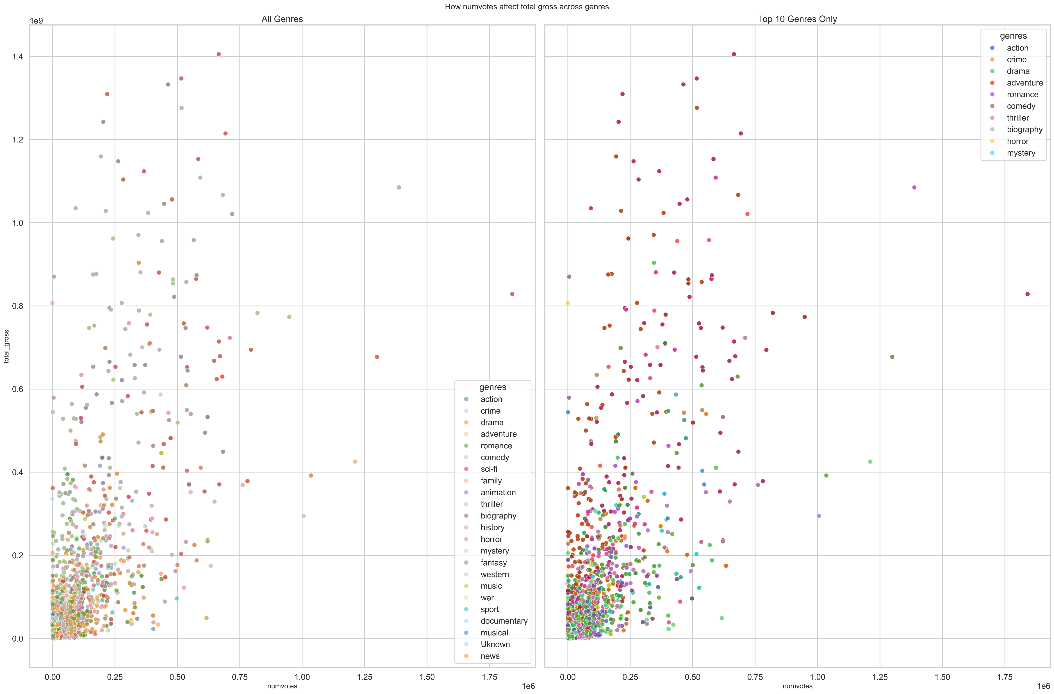

Slide 8
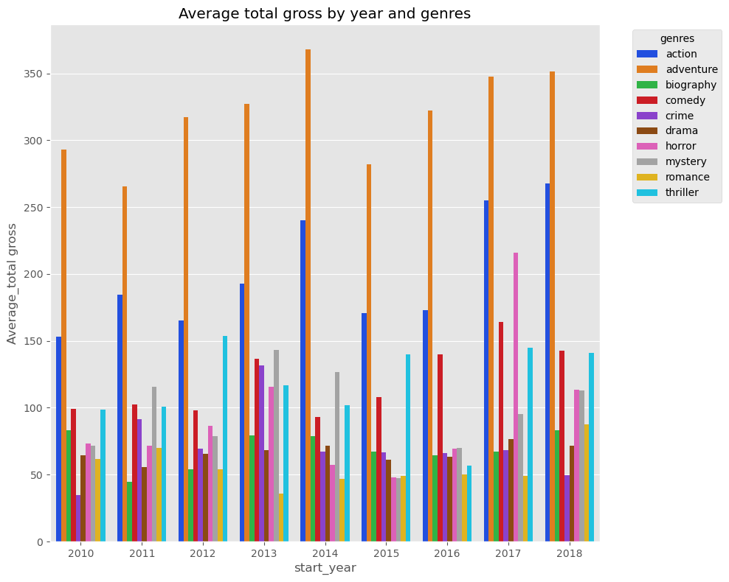
Bar Plot – Total Gross by Genre and Year:

Slide 9
Heat map
The heat map shows that total gross is positively correlated to most of the numeric variable with most of the variables being weakly correlated or not correlated at all
Number of votes has the strongest correlation of 0.67 this suggesting that films with high number of votes are likely to earn more total gross

Slide 10
Scatter plot
There is positive correlation between total gross and number of vote eventhough it is not that linear . This suggest that some moves may be highly voted but still earn lowest total gross
Genres like action adventures are spread across the whole plot making them the most suitable for commercial
The bottom left conner is most dense showing that films with lower number of votes are likely to have low total gross

Slide 11
Bar plot
The bar plot clearly shows to us that over the years adventure and action genres have been the best performing films generally this suggesting that they are the best for comercial

Slide 12
Conclusions
Recommendations for Microsoft:
Focus on Action ,Adventure , and Biography genres to increase potentials
Support genres decisions with market trends data but also asses long term sustainability beyond blockbuster outliers
Consider highly rated and frequently voted titles as signal of appeal
Limitations
Data limited to films with complete financial information
No access to production budget or streaming metrics
Next Steps
Predict revenue using regression models on cleaned features

Slide 13
For more info:
Contact:
Email[princevalentine879@gmail.com]
Git Hub []

